Slide 1
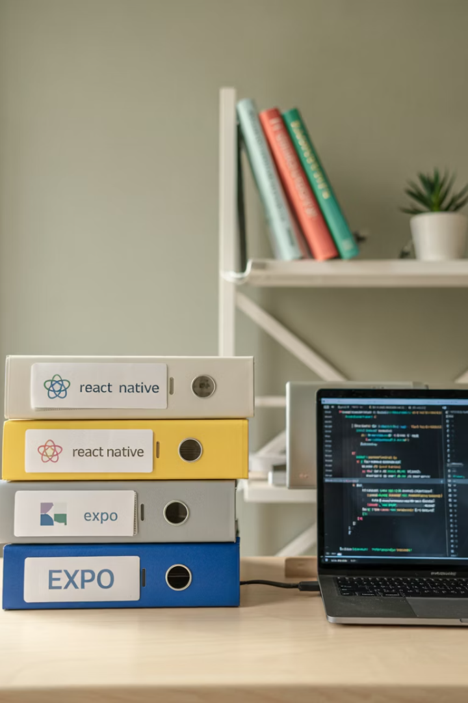

Navigating React Native Project Structure
Welcome to this comprehensive guide on navigating the project structure in React Native applications. Understanding the folder and file organization is essential for efficient development, improved maintainability, and effective team collaboration.
Throughout this presentation, we'll explore the various components that make up a React Native project, examine the Expo commands for project creation, and detail the purpose of each folder and file in your development environment.

Slide 2

Why Project Structure Matters
Organization
A well-structured project makes it easier to locate specific components and functionality, reducing development time.
Maintainability
Proper organization ensures code can be maintained and updated efficiently as your application grows.
Collaboration
Consistent structure helps team members understand the codebase quickly and work together effectively.
Scalability
A thoughtful structure allows your application to grow without becoming unwieldy or difficult to navigate.

Slide 3



Creating Projects with Expo
npx create-expo-app@latest
Creates a comprehensive project structure with organized folders for different aspects of development
npx create-expo-app anotherapp --template blank
Creates a minimal project structure with fewer files and folders for simpler applications
Expo commands help you initialize React Native projects with predefined structures. The npx tool allows you to run npm packages without installing them globally on your system, making project setup more efficient.

Slide 4

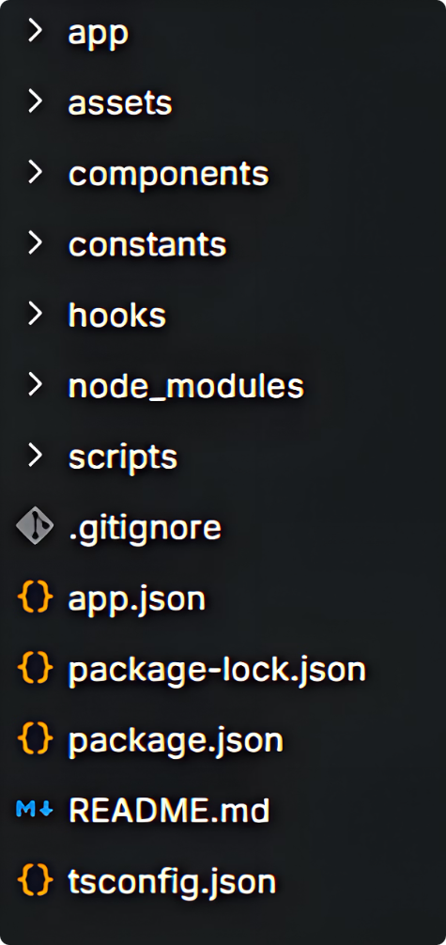
Full Template Structure
Command Execution
Running npx create-expo-app@latest without templates generates a comprehensive project structure with all standard files and folders.
This full template includes configuration files, assets directory, and component organization designed to support complex application development from the start.

Slide 5




The .expo Folder
Internal Directory
Configuration Storage
Automatic Management
Developed by Expo as an internal directory specifically for the project
Contains configurations specific to your development environment
Managed automatically by Expo; developers don't interact with it directly
The .expo folder serves as the backbone for Expo-specific configurations in your React Native project. While you won't need to modify its contents manually, it's crucial for the proper functioning of your Expo development environment.

Slide 6








Core Application Folders
App Folder
Assets Folder
Stores major application flow, core views, navigation bindings, and other top-level entities
Contains static content like images, fonts, and other media for your application
Constants Folder
Components Folder
Stores constant values and configuration settings for consistent application behavior
Groups reusable UI components to improve code reusability

Slide 7




Specialized Development Folders
Hooks Folder
node_modules Folder
Scripts Folder
Contains utilities built with React Hooks that include reusable logic for state management, effects, and other functionalities
Stores script files that automate project responsibilities like build processes or deployment tasks
Includes all installed dependencies and packages required by your project, automatically managed by npm or Yarn

Slide 8




Configuration Files (Part 1)
.gitignore
Determines which files and directories to exclude from version control in Git, such as node_modules, .expo/, and environment files
babel.config.js
Specifies how Babel should transpile your JavaScript files, allowing you to add or change plugins and presets
expo-env.d.ts
TypeScript declaration file that assigns types to Expo environment variables and other TypeScript-based configurations

Slide 9



Configuration Files (Part 2)
package-lock.json
Automatically generated by npm to specify exact version numbers of dependencies
package.json
Contains meta information about the project including dependencies, scripts, and configurations
README.md
Markdown file explaining the project, setup instructions, and usage details
These configuration files are essential for maintaining consistency across development environments and providing important information about your project to other developers.

Slide 10
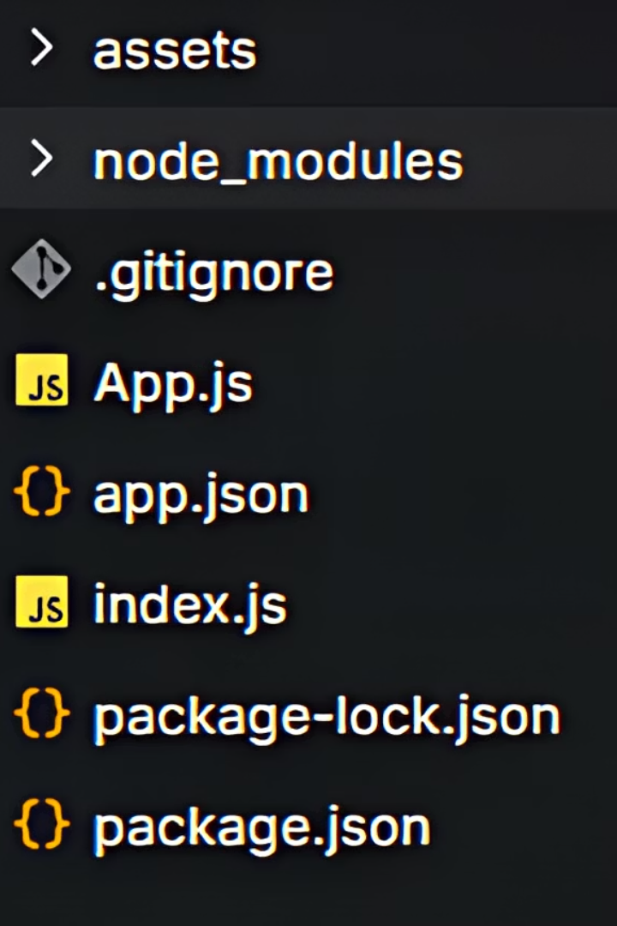
Minimal Template Structure
Command Execution
Run npx create-expo-app anotherapp --template blank to create a project with minimal structure
Folder Generation
Creates fewer folders compared to the standard template, focusing on essential components only
App.js Addition
Includes app.js file with the basic layout of React Native code for immediate UI development
The minimal template is ideal for smaller projects or when you prefer to build your structure incrementally as your application grows. It provides just enough to get started without overwhelming you with unnecessary files.

Slide 11
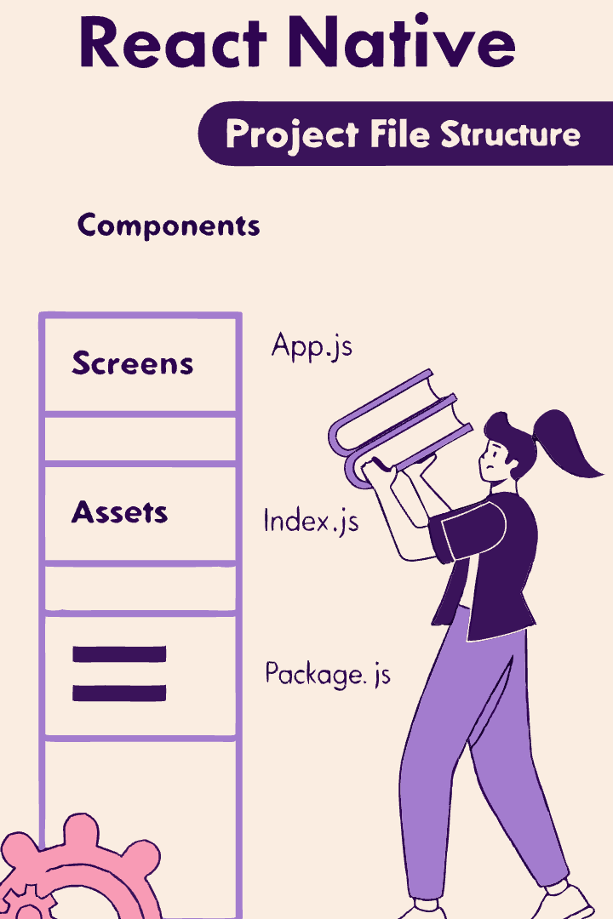
Comparing Project Structures
Full Template (npx create-expo-app@latest)
Minimal Template (--template blank)
.expo, app, assets, components, constants, hooks, node_modules, scripts
.expo, assets, node_modules
.gitignore, app.json, babel.config.js, expo-env.d.ts, package-lock.json, package.json, README.md
.gitignore, app.js, app.json, babel.config.js, package-lock.json, package.json
Comprehensive organization for larger projects
Streamlined structure for simpler applications

Slide 12








Best Practices for Project Organization
Consistent Naming
Use clear, consistent naming conventions for files and folders
Logical Grouping
Group related files together in appropriate folders
Modular Structure
Organize code into reusable, independent modules
Documentation
Maintain clear documentation of your project structure
Following these best practices will help ensure your React Native project remains organized and maintainable as it grows. A well-structured project saves development time and reduces the learning curve for new team members.

Slide 13

Key Takeaways
2
10+
Expo Commands
Essential Files
Different commands create different project structures based on your needs
Understanding key files and folders improves development efficiency
4
Core Folders
App, assets, components, and constants form the backbone of your project
A well-organized project structure is fundamental to successful React Native development. By understanding the purpose of each folder and file, you can create more maintainable, collaborative, and scalable applications. Whether you choose a comprehensive or minimal template, the principles of good organization remain the same.

